Slide 1
MBJ Coffee Expansion Analysis
By: Tom Barasa
05/10/2022

Slide 2
MBJ Coffee Expansion Analysis
MBJ Coffee shop, is a relatively small company which can’t compete with big players in the current market. The company’s strategy is to build a vast network of shops in smaller cities. MBJ Coffee shop already has a strong presence in 140 locations and recently opened stores in 10 new cities. Additionally, the company has two separate sales regions.
The company wants to:
1) Identify which of the two sales regions is performing better (outperforming the other in 2 of the following 3 metrics).
Average Revenue per City.
Average Marketing spend per city(tip- less is better).
Average ROMI (Return on Marketing Investment) per city. Calculated as (revenue/marketing spend).
2). Identify which of the 10 new locations have the best potential for the company to invest more funds into marketing.

Slide 3
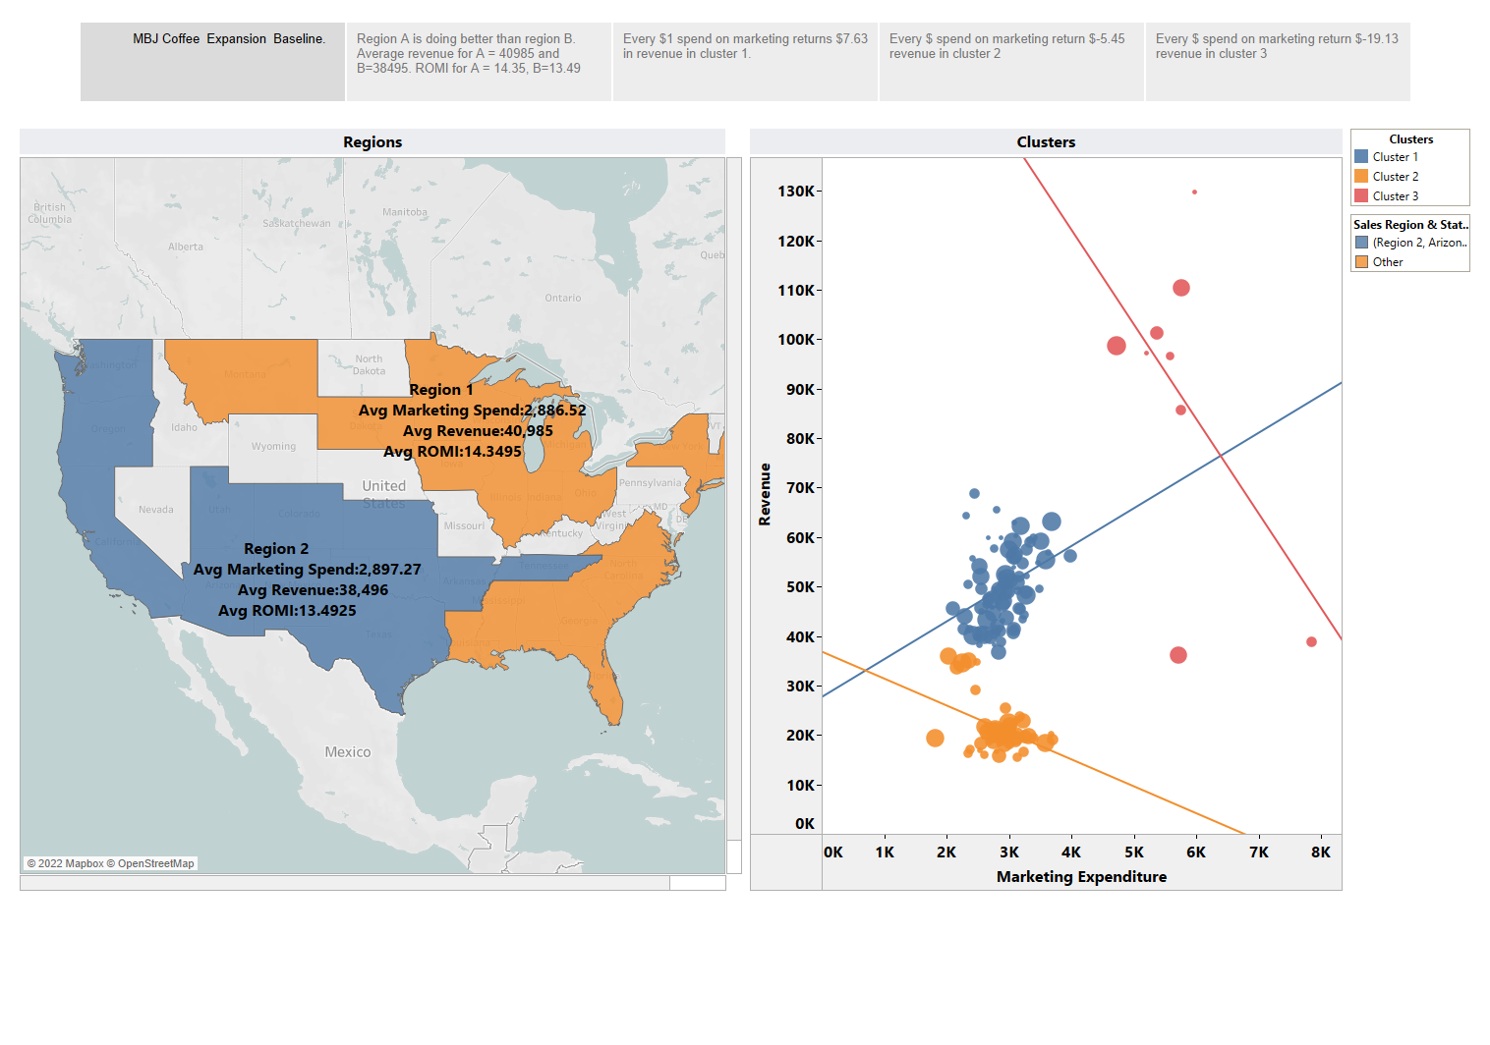

Slide 4
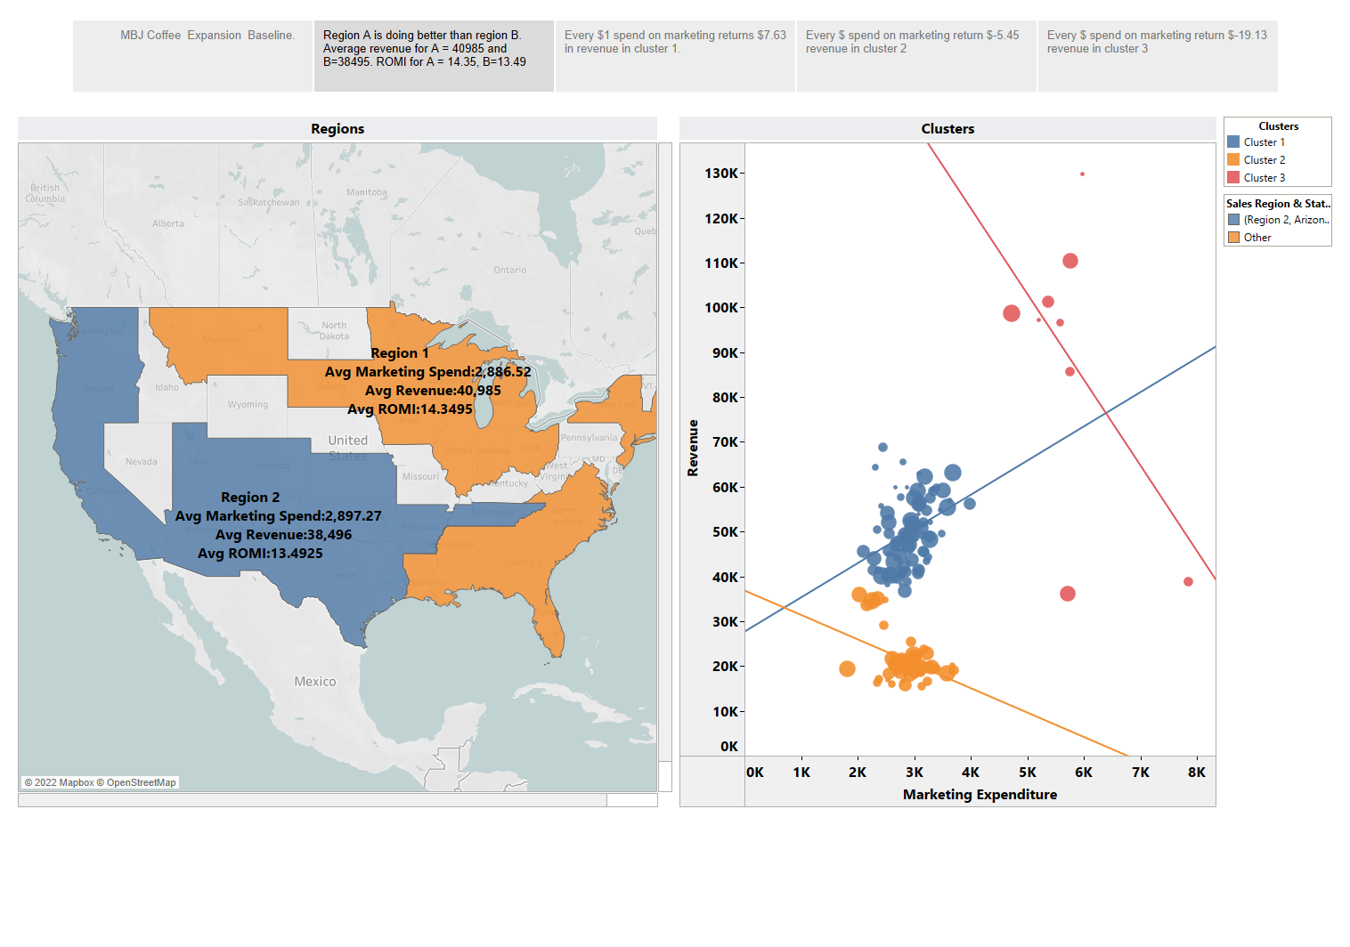

Slide 5
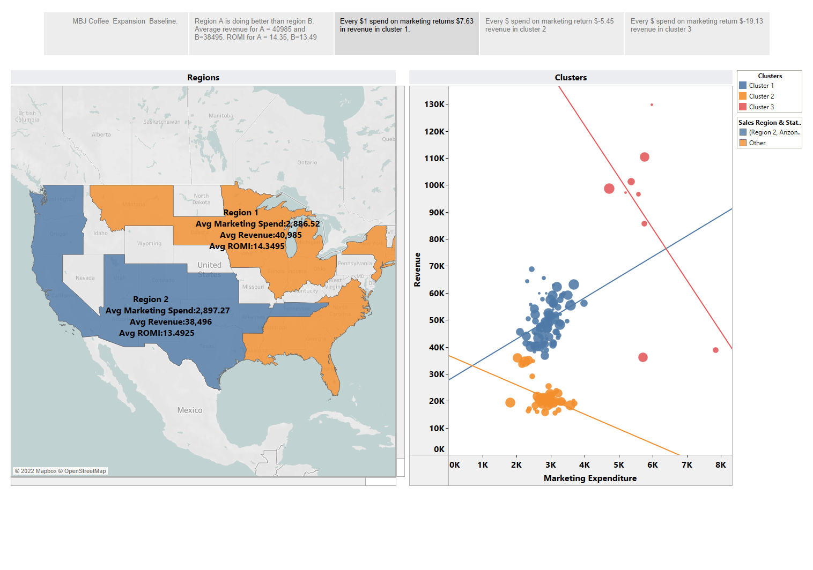

Slide 6
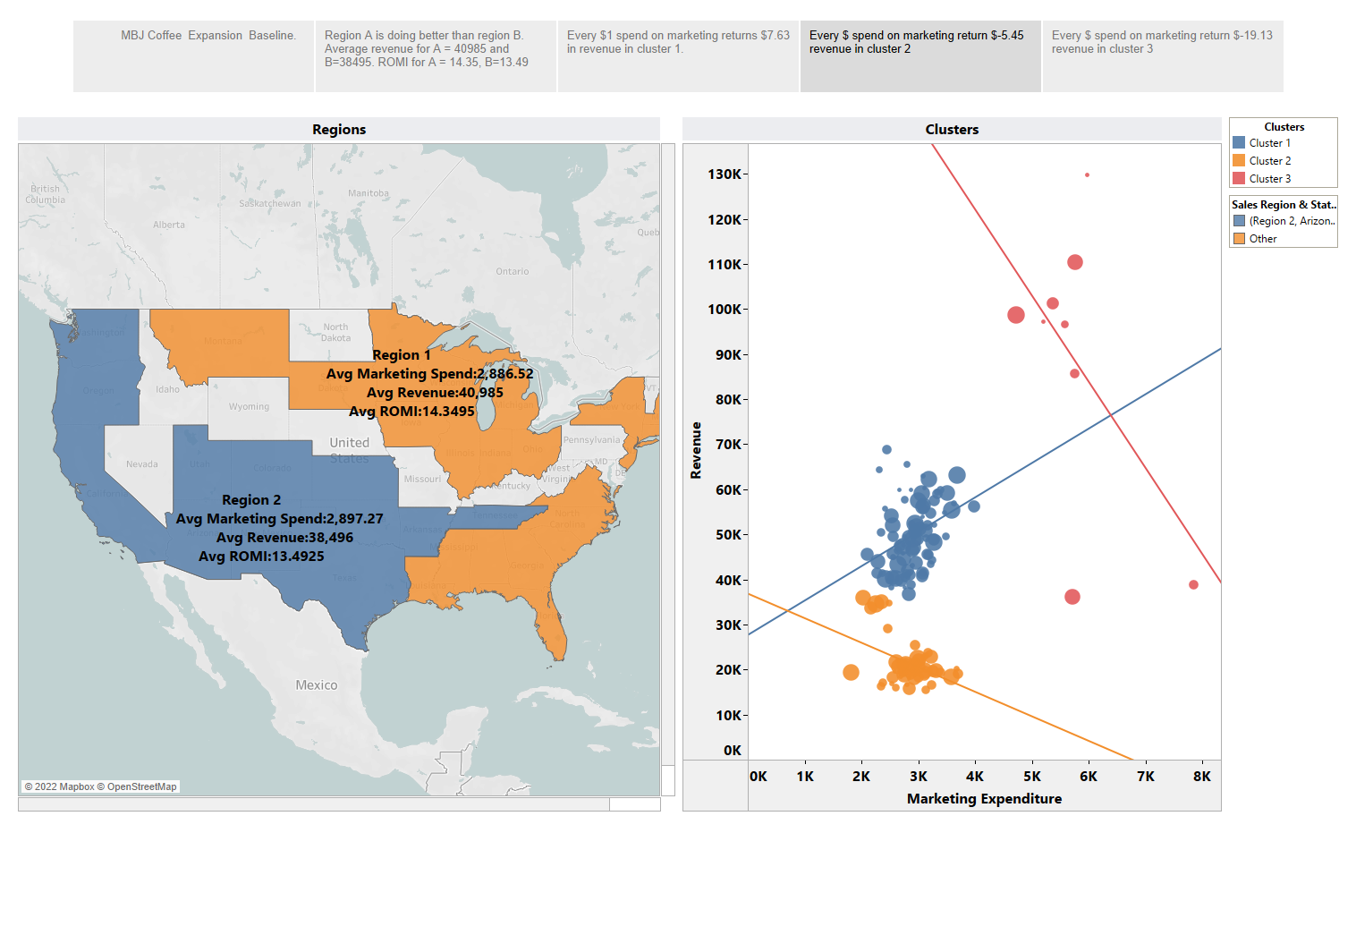

Slide 7
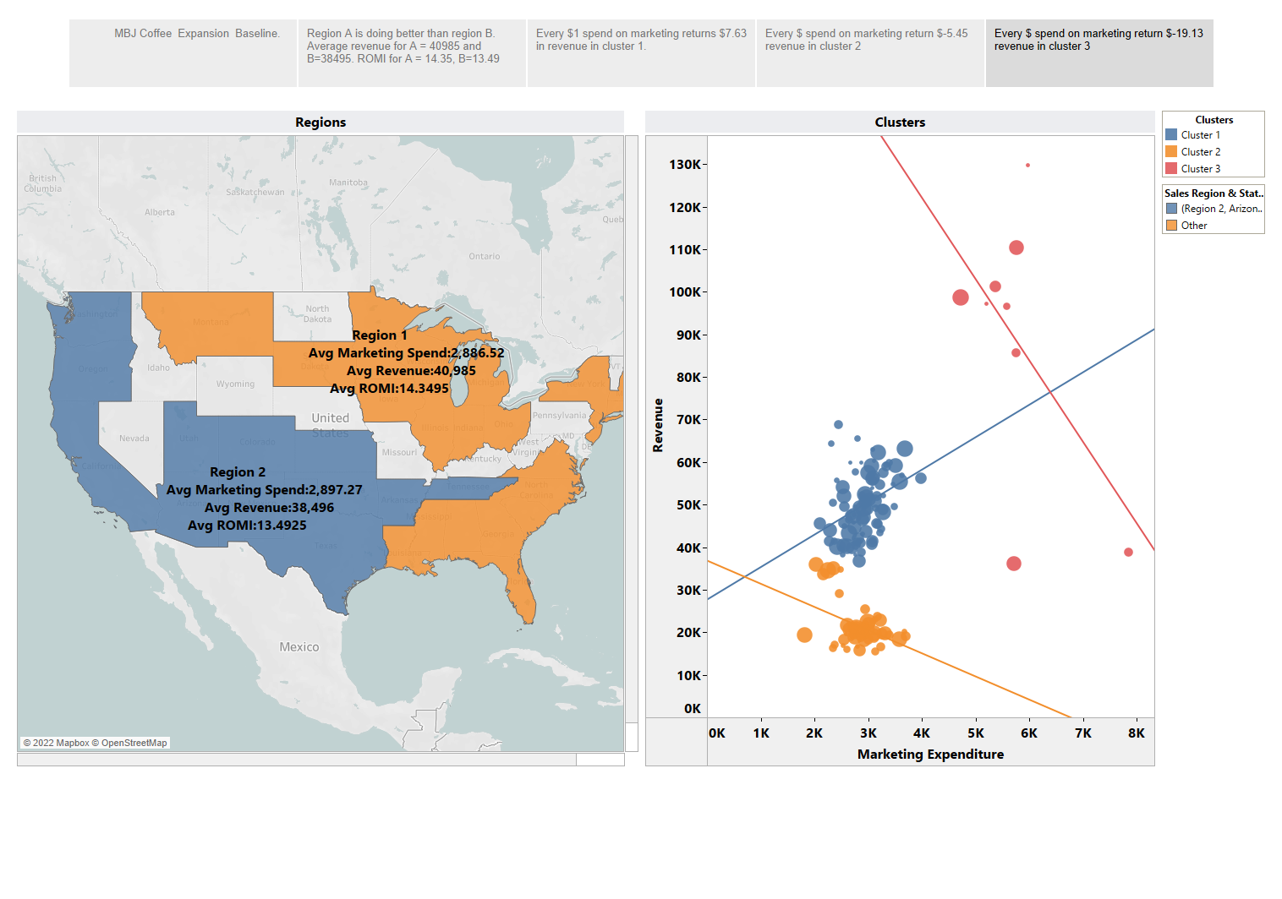

Slide 8
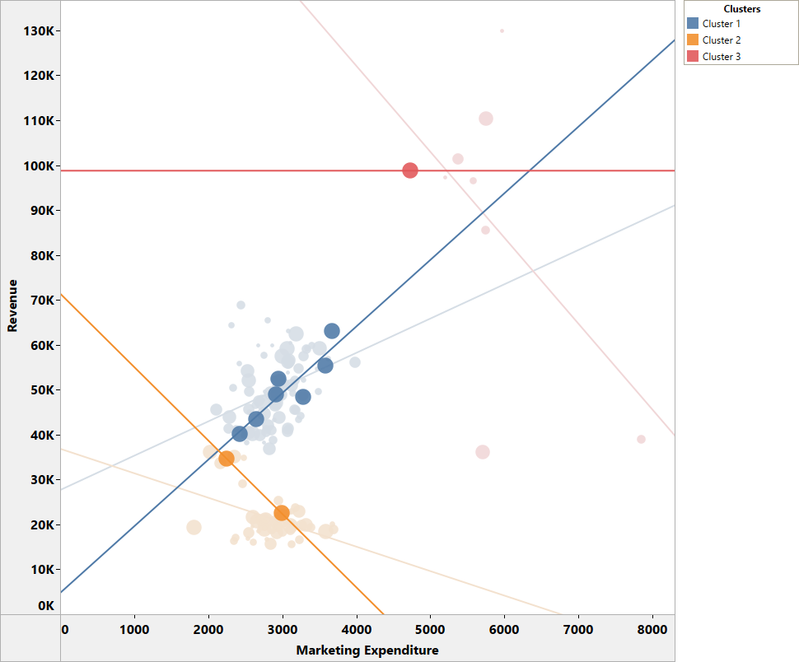
10 Best Locations to Invest more funds in marketing.

